Slide 1
RULE UP FOR 3 COLOUMN NOTES

Slide 2
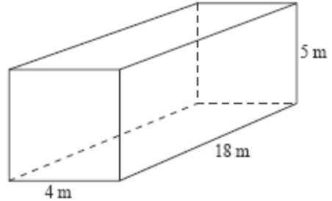
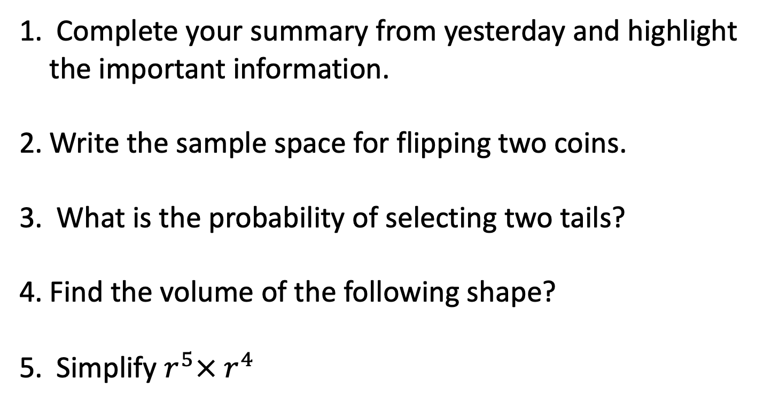
24
7
30
Date
Index Laws
EQ – Describe how the index laws can be used to simplify expressions with indices.
FIRST 5 QUESTIONS
Complete your summary from yesterday and highlight the important information.
Write the sample space for flipping two coins.
What is the probability of selecting two tails?
Find the volume of the following shape?
Simplify $r^{5}× r^{4}$
5

Slide 3
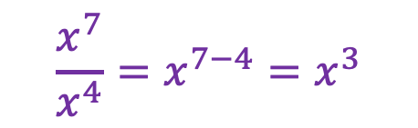

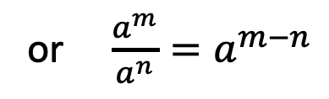




24
7
30
Date
Index Laws
EQ – Describe how the index laws can be used to simplify expressions with indices.
What are index laws?
Index laws are the rules for simplifying expressions involving powers of the same base number.
Multiplication Law
Example
How do I use the multiplication law?
$$x^{7}×x^{4}=x^{7+4}=x^{11}$$
$$a^{m}×a^{n}=a^{m+n}$$
$$2^{3}×2^{2}=2^{3+2}= 2^{5}$$
Division Law
Example
$$a^{m}÷a^{n}=a^{m−n}$$
$$x^{7}÷x^{4}=x^{7−4}=x^{3}$$
How do I use the division law?
or $\frac{a^{m}}{a^{n}}=a^{m−n}$
$$\frac{x^{7}}{x^{4}}=x^{7−4}=x^{3}$$
5

Slide 4

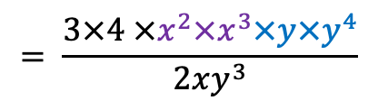
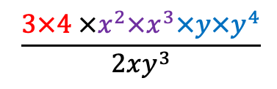
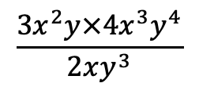
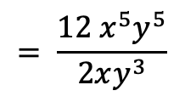

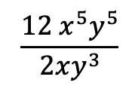
24
7
30
Date
Index Laws
EQ – Describe how the index laws can be used to simplify expressions with indices.
How to simplify a multi-step problem?
1. Collect like terms
1.
$$\frac{3x^{2}y×4x^{3}y^{4}}{2xy^{3}}$$
$$= \frac{3×4 ×x^{2}×x^{3}×y×y^{4}}{2xy^{3}}$$
2a. Solve the numbers
2b. Simplify with the multiplication law
$$\frac{3×4 ×x^{2}×x^{3}×y×y^{4}}{2xy^{3}}$$
$$= \frac{12 x^{5}y^{5}}{2xy^{3}}$$
2.
3a. Solve the numbers
3b. Simplify with the division law
3.
$$\frac{12 x^{5}y^{5}}{2xy^{3}}$$
$$=12÷2 × x^{5−1}y^{5−3}$$
5. Answer
$$=6 x^{4}y^{2}$$
5

Slide 5
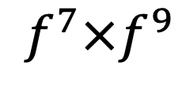
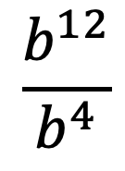
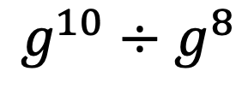
We Do
$$f^{7}×f^{9}$$
$$g^{10}÷g^{8}$$
$$\frac{b^{12}}{b^{4}}$$
Notes:
There is also worksheets uploaded.

Slide 6
Task
Dwyer Text Book Page 4
Exercise 1.5
Dwyer Text Book Page 5
Exercise 1.6
Notes:
There is also worksheets uploaded.

Slide 7

Exit Ticket
TASK - On a sticky note provided.
1. Write your name on one side
Answer the following 2 questions
Hand into your teacher with all the above to leave ☺
Solve:
$$t^{5} ×{ t}^{12}$$
$\frac{{h^{6}p}^{3}}{h^{2}p}$

Slide 8
Homework
Review your notes and write a summary answering the essential question.

